Slide 1
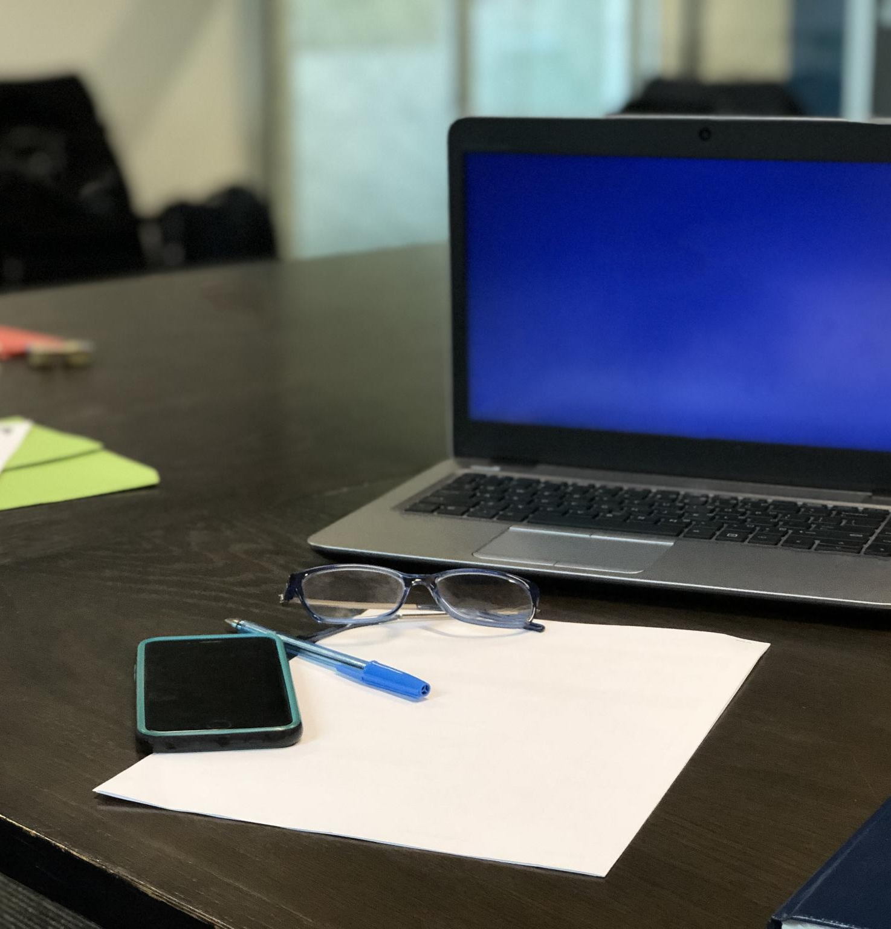
SEC285 Final Project Presentation
Melisha Peel
Pro. Christina Bailey
Notes:
---

Slide 2
SEC285 Final Project Overview
Notes:
Title Slide, Introduction, Challenges, Career Skills, Conclusion, References

Slide 3

Title Slide
Project Overview
  The presentation summarizes the SEC285 final project’s objectives and main content for academic review.
Professional Presentation
  The slides are designed with a professional and structured layout suitable for academic and career audiences.
Academic Context
  The presentation includes course details and submission date to provide proper academic context.
Notes:
This presentation, titled 'SEC285 Final Project', was developed by [Your Name] as part of the SEC285 course. It provides a comprehensive overview of the final project, including its objectives, challenges faced, career skills gained, and concluding insights. The presentation is designed to reflect a professional appearance and structure, suitable for academic and career-oriented audiences. The date of submission and course details are also included to contextualize the project within the academic timeline.

Slide 4

Introduction
Project Objectives
  Demonstrate proficiency in network security concepts and apply theoretical knowledge practically.
Project Scope
  Covers threat analysis, mitigation strategies, and secure configuration practices in networks.
Presentation and Documentation
  Showcase ability to document and present technical findings effectively in the project.
Notes:
The introduction slide outlines the purpose and scope of the SEC285 final project. It begins by stating the primary objectives, which include demonstrating proficiency in network security concepts, applying theoretical knowledge to practical scenarios, and showcasing the ability to document and present technical findings. The scope of the project encompasses various aspects of network security such as threat analysis, mitigation strategies, and secure configuration practices. This slide sets the stage for the detailed discussion that follows, providing the audience with a clear understanding of what the project entails and its relevance to the course curriculum.

Slide 5

SEC285
Module 2
Asymmetric Key Encryption

Slide 6
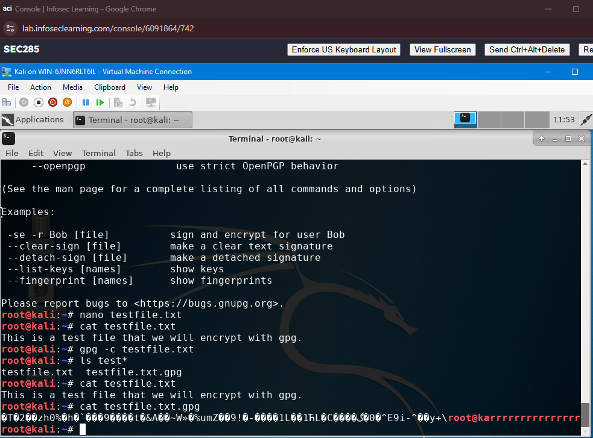
File Encryption
This screenshot should show the following.
Content of the plaintext file
Content of the encrypted file

Slide 7
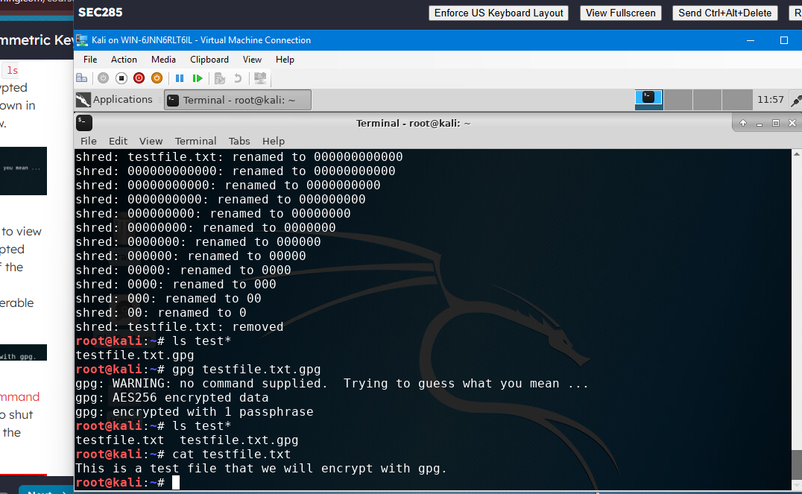
File Decryption
This screenshot should show the following.
The encrypted file being listed by itself
The decrypting process
Both the encrypted file and the original plaintext file being listed

Slide 8
SEC285
Module 3
Stateful Firewall

Slide 9

Question
What effect does the sudo iptables --policy INPUT DROP command have on the access to computing resources?
Answer here:
That command drops all incoming connections incoming to the server.
References:
Lab

Slide 10
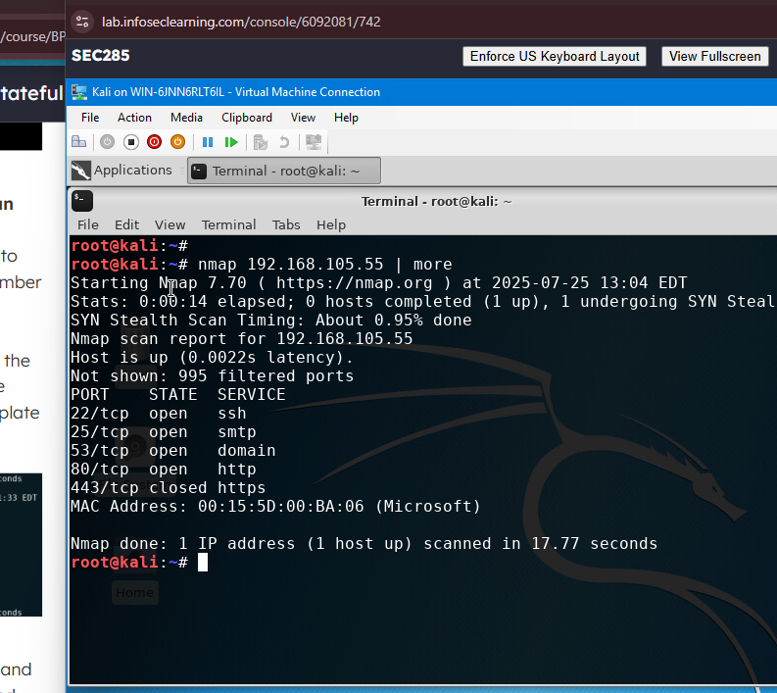
Nmap Scan
This screenshot should show the Nmap scan result of the Linux Server VM.

Slide 11

SEC285
Module 4
Bring Your Own Device (BYOD)
Security Policy

Slide 12
Overview:
In today’s digital workplace, tablets, smartphones, and laptops are essential tools that enhance productivity, flexibility, and connectivity. These mobile devices are widely used across modern enterprises to access corporate email, cloud services, and internal applications, often from remote or hybrid work environments. However, their widespread use also introduces significant security risks, including data leakage, unauthorized access, malware infections, and loss or theft of devices. As a result, organizations must implement clear policies to manage and secure personal devices that connect to corporate networks.
2. Purpose:
The purpose of this BYOD Security Policy is to protect the confidentiality, integrity, and availability (CIA) of the organization’s data and systems. By establishing clear guidelines for the use of personal devices, this policy aims to identify and mitigate vulnerabilities that could be introduced through BYOD practices. Timely discovery and management of these vulnerabilities help reduce the attack surface and prevent potential breaches, ensuring that personal device usage does not compromise the security of the organization’s computing resources.

Slide 13
3. Scope:
This policy applies to all employees, contractors, consultants, temporary workers, and other personnel who use personally owned mobile devices, including smartphones, tablets, and laptops—to access corporate systems, data, or services. It covers both on-site and remote access to the organization’s network and resources.
4. Policy:
Device Enrollment: All personal devices must be registered with the IT department and approved before accessing corporate resources.
Security Requirements: Devices must have up-to-date operating systems, antivirus software, and support for encryption and remote wipe.
Access Control: Access to sensitive data will be granted based on job role and business need. Multi-factor authentication (MFA) is required.
Acceptable Use: Personal devices may be used for work-related tasks only. Users must not install unauthorized apps or access inappropriate content while connected to the corporate network.
Data Protection: Company data must be accessed through secure apps or virtual environments. Local storage of sensitive data is prohibited unless encrypted.
Monitoring: The organization reserves the right to monitor device access and usage to ensure compliance with this policy.

Slide 14
5. Policy Compliance:
Violations: Any user found to have violated this policy may be subject to disciplinary action, including revocation of BYOD privileges, suspension, or termination.
Audits: Regular audits may be conducted to ensure compliance with BYOD security requirements.
Incident Reporting: Users must report lost or stolen devices, or any suspected security incidents, to the IT department immediately.
6. Related Standards, Policies, and Processes:
This policy should be read in conjunction with the following documents:
Information Security Policy
Acceptable Use Policy
Data Classification and Handling Policy
Incident Response Plan
Mobile Device Management (MDM) Guidelines

Slide 15
7. Definitions and Terms:
BYOD (Bring Your Own Device): A policy that allows employees to use their personal mobile devices (smartphones, tablets, laptops) to access organizational systems and data.
Mobile Devices: Portable computing devices such as smartphones, tablets, and laptops that can connect to corporate networks and access data.
CIA Triad: A foundational model in information security that stands for Confidentiality, Integrity, and Availability—the three core principles for protecting data.
Encryption: The process of converting data into a coded format to prevent unauthorized access.
Multi-Factor Authentication (MFA): A security mechanism that requires users to provide two or more verification factors to gain access to a resource.
Remote Wipe: A security feature that allows data on a mobile device to be erased remotely in case of loss or theft.
8. Revision History: >>>>>>>>>
Date of change | Responsible | Summary of change
August 2019 | SANS policy team | Updated and converted to new format
July 2025 | Melisha Peel | Initial draft of BYOD Security Policy

Slide 16
SEC285
Module 5
Multifactor Authentication (MFA)

Slide 17
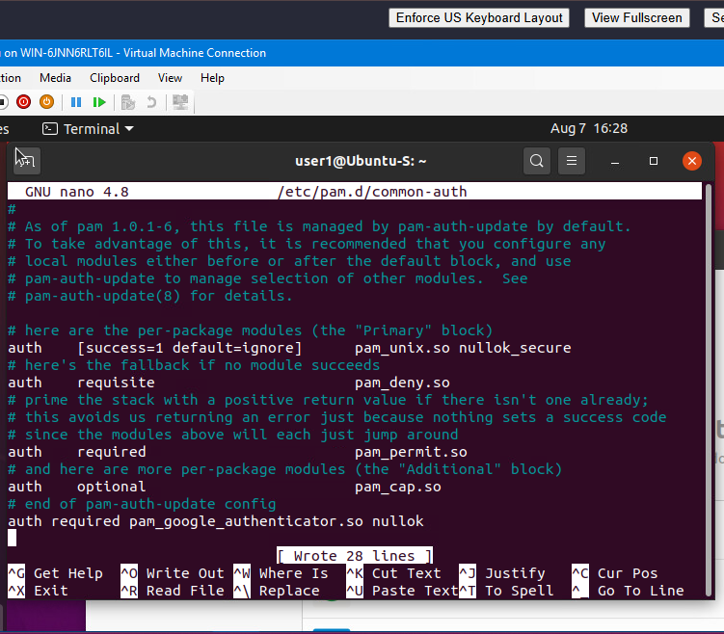
Common-auth Configuration File
This screenshot should show the entry that indicates the use of the Google Authenticator module.

Slide 18
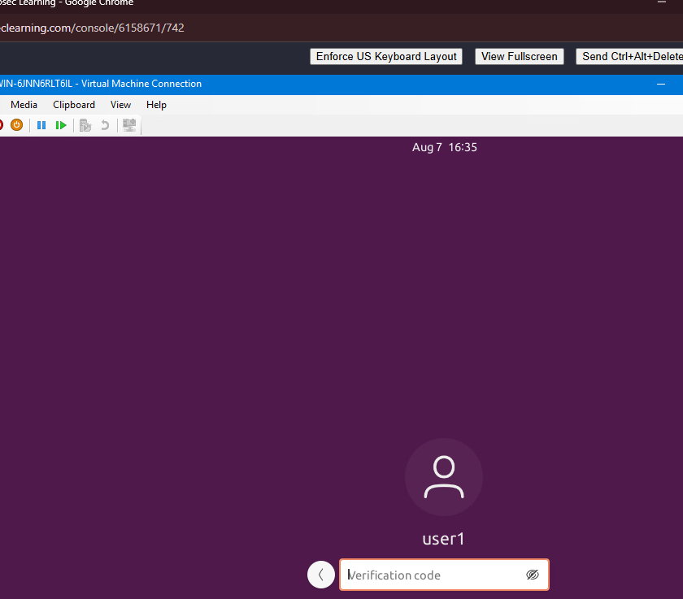
MFA Logon Screen
This screenshot should show the logon screen where a verification code is required.

Slide 19

SEC285
Module 6
Vulnerability Assessment

Slide 20
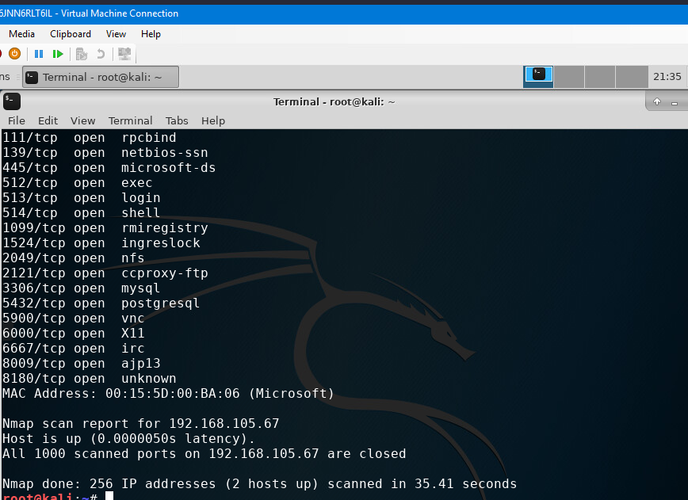
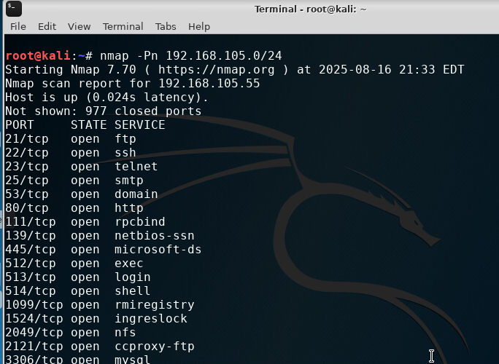
Nmap
This screenshot should include the scan result showing both the Kali and Linux Server VMs.

Slide 21
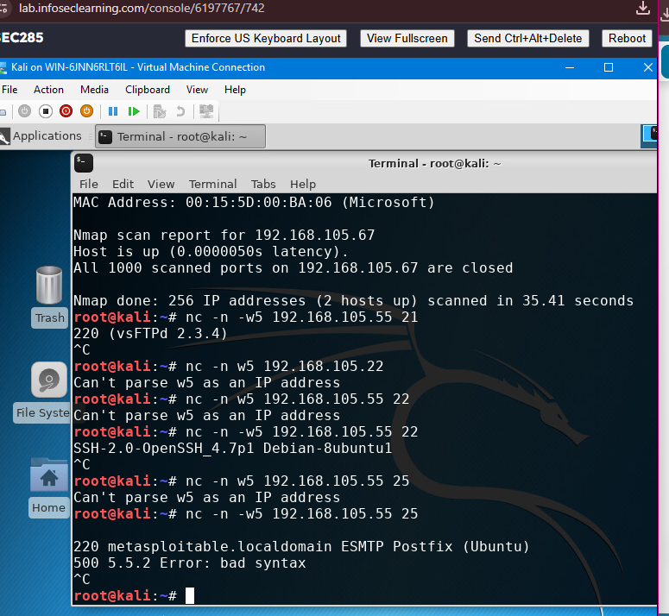
NetCat
This screenshot should include the scan result showing both the Kali and Linux Server VMs.

Slide 22
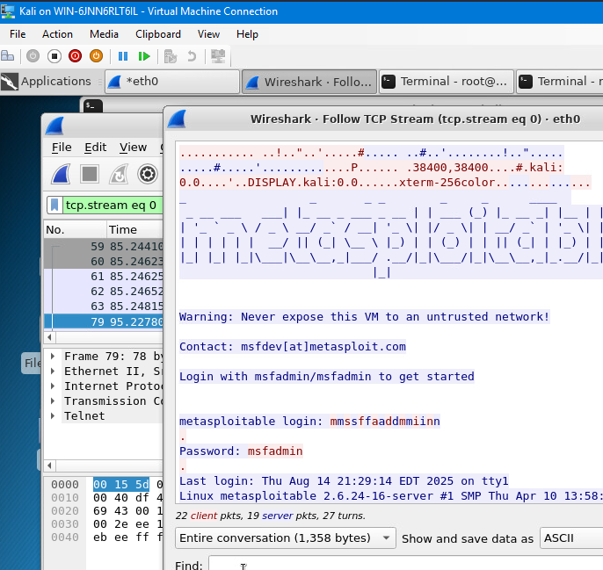
Wireshark
This screenshot should include the Wireshark—Follow TCP Steam window showing the Telnet username and password.

Slide 23
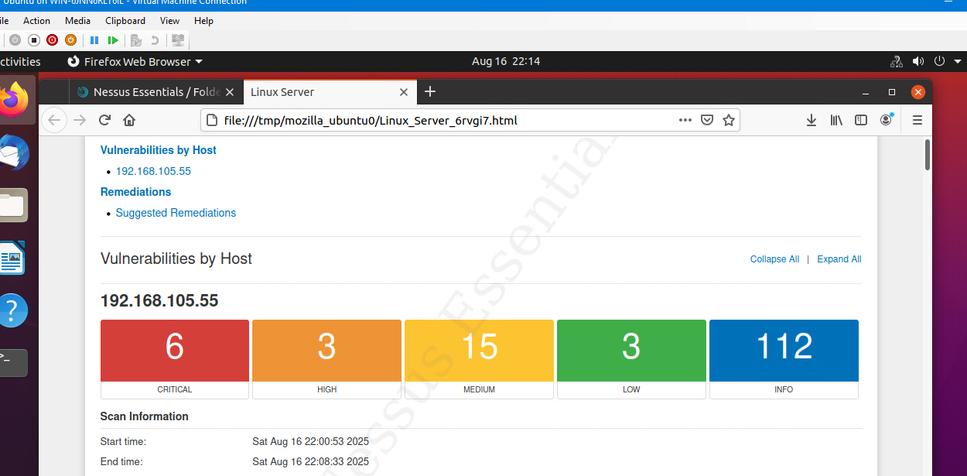
Nessus
This screenshot should include the high-level view of the Nessus vulnerability scan report (showing categories of vulnerability in different colors).

Slide 24

Challenges
Resource Limitations
  Limited access to advanced tools and testing environments challenged effective security configuration implementations.
Time Constraints
  Strict deadlines required efficient time management and prioritization to meet project goals.
Technical Difficulties
  Troubleshooting network issues and ensuring system compatibility posed significant technical challenges.
Collaboration and Problem Solving
  Teamwork, research, and persistent problem-solving helped overcome challenges effectively.
Notes:
Throughout the duration of the SEC285 final project, several challenges were encountered that tested both technical and soft skills. One major challenge was the limitation of resources, including access to advanced tools and environments for testing security configurations. Another significant hurdle was time constraints, which required efficient time management and prioritization of tasks. Technical difficulties also arose, such as troubleshooting network issues and ensuring compatibility across different systems. These challenges were addressed through extensive research, collaboration with peers and instructors, and persistent problem-solving efforts. This slide highlights the resilience and adaptability required to overcome obstacles in a real-world project setting.

Slide 25
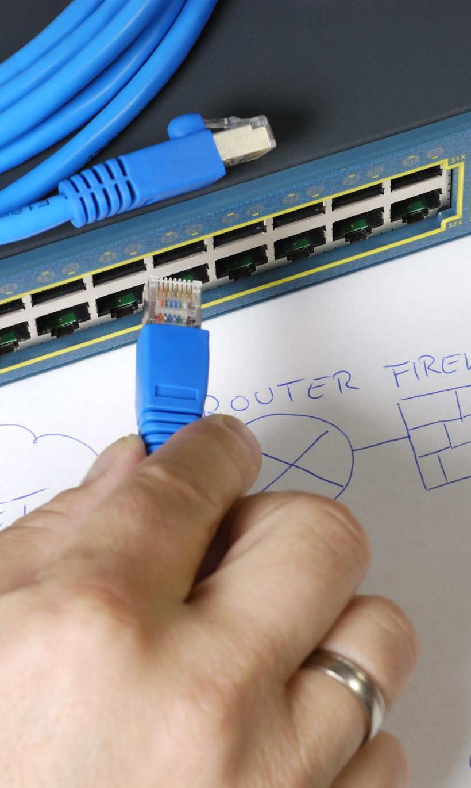
Career Skills
Network Security Fundamentals
  The project enhanced understanding of key network security concepts including protocols and threat mitigation techniques.
Troubleshooting Skills
  Improved problem-solving abilities essential for diagnosing and resolving IT network issues effectively.
Technical Documentation
  Emphasized clear and concise documentation of technical findings and network configurations.
Communication Skills
  Fostered ability to convey complex technical information clearly to diverse audiences through presentations.
Notes:
The SEC285 final project provided an excellent opportunity to develop and refine several career-relevant skills. Firstly, it enhanced understanding of network security fundamentals, including protocols, threat detection, and mitigation techniques. Secondly, the project improved troubleshooting and problem-solving abilities, essential for any IT professional. Thirdly, it emphasized the importance of technical documentation, requiring clear and concise reporting of findings and configurations. Lastly, the presentation component of the project fostered communication skills, enabling the effective conveyance of complex technical information to diverse audiences. These skills collectively contribute to a strong foundation for a career in cybersecurity and network administration.

Slide 26
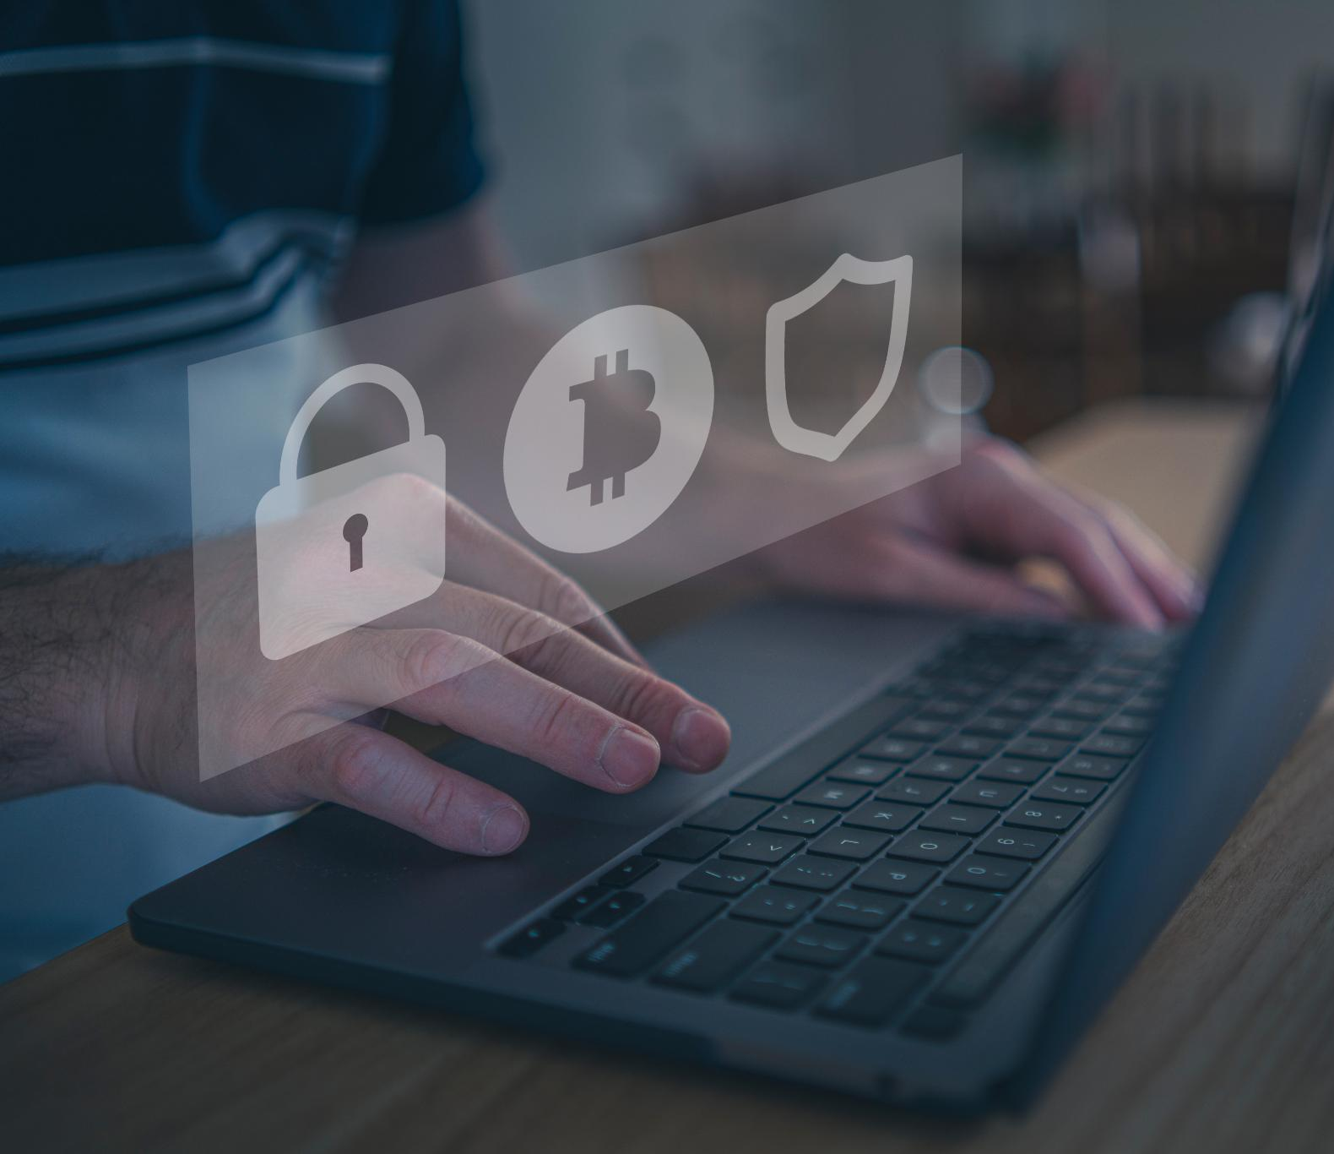
Conclusion
Bridging Theory and Practice
  The project connected theoretical concepts with real-world network security applications, enhancing practical understanding.
Skill Development
  It fostered critical thinking, technical abilities, and professional competencies essential for cybersecurity careers.
Overcoming Challenges
  Facing challenges during the project emphasized persistence and adaptability as key learning outcomes.
Career Preparedness
  The experience significantly prepared the student for future roles in cybersecurity and IT fields.
Notes:
In conclusion, the SEC285 final project was a valuable educational experience that bridged the gap between theoretical learning and practical application. It allowed for the exploration of real-world network security scenarios, the development of critical thinking and technical skills, and the demonstration of professional competencies. The challenges faced during the project served as learning opportunities, reinforcing the importance of persistence and adaptability. Overall, the project has significantly contributed to the preparedness of the student for future roles in the cybersecurity and IT fields, aligning well with the goals of the SEC285 course.

Slide 27

References
Course Materials
  SEC285 course materials provided foundational knowledge and guidelines essential for the project development.
  Previous Module Project Submissions
Notes:
The references slide includes all sources consulted during the development of the SEC285 final project. These include SEC285 course materials, which provided foundational knowledge and guidelines; Cisco Networking Academy resources, which offered practical insights and tutorials; official documentation and whitepapers from industry leaders, which ensured accuracy and relevance; and online forums and tutorials that supported troubleshooting and advanced configurations. Proper citation of these resources underscores the academic integrity and thorough research involved in the project.

